Slide 1

A Product Recommendation system that recommends quality products by exploiting user written reviews
Group 1
Roll Number | Student Name
CB.EN.U4CSE19602 | Adarsh Jayan
CB.EN.U4CSE19615 | Dev Divyendh
CB.EN.U4CSE19626 | Karthik Shriram
CB.EN.U4CSE19649 | Sri Chakra Teja

Slide 2
introduction
Now a days , product reviews play an important role in deciding whether a product is good or bad, it basically decides the products reputation, we now have various methods for describing with the help of rating scales and reviews. Reviews and rating play an essential role for other users to decide whether a product is worth the cost or not.

Slide 3
Problem statement
The goal of this project is to provide an interface with a Product Recommendation System with Collaborative Filtering and a user-based recommendation system where user pooling is done using Natural Language Processing on user-written reviews and ratings.
The processing of user reviews has been completed. Deep Neural Networks are used to build and optimize the ML model.
Dataset : https://www.kaggle.com/datafiniti/consumer-reviews-of-amazon-products
This is a list of over 34,000 consumer reviews for Amazon products like the Kindle, Fire TV Stick. The dataset includes basic product information, rating, review text, and more for each product

Slide 4
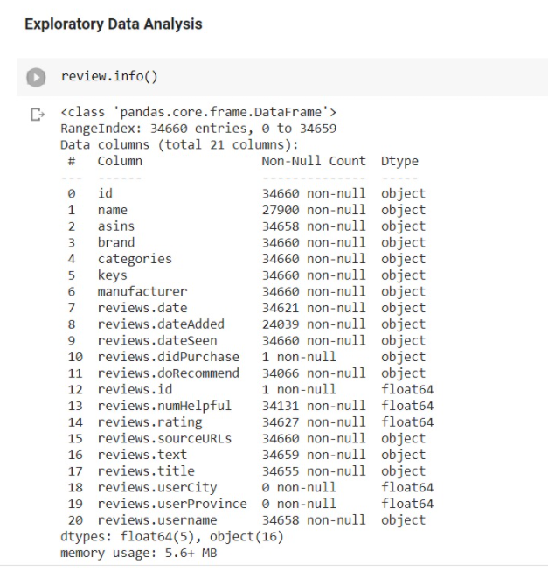
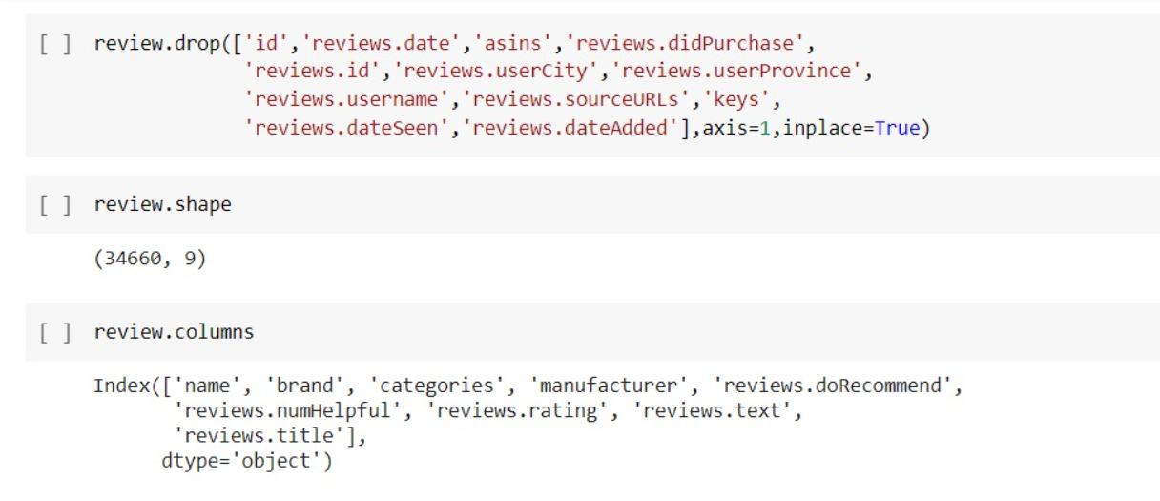
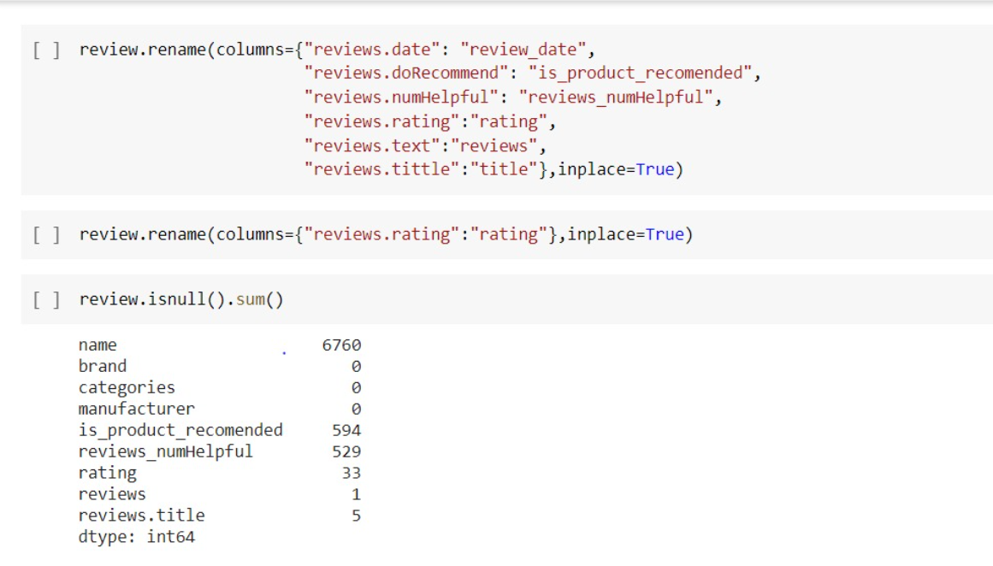
Exploratory data analysis

Slide 5
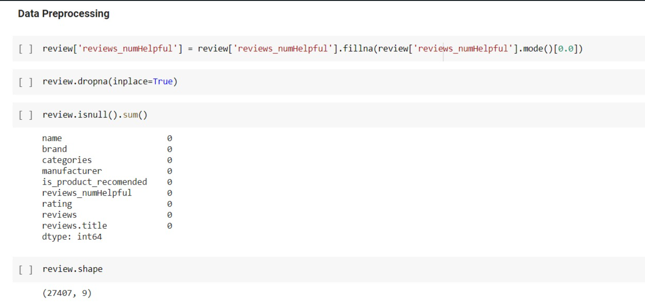
Data preprocessing
Filling missing values

Slide 6
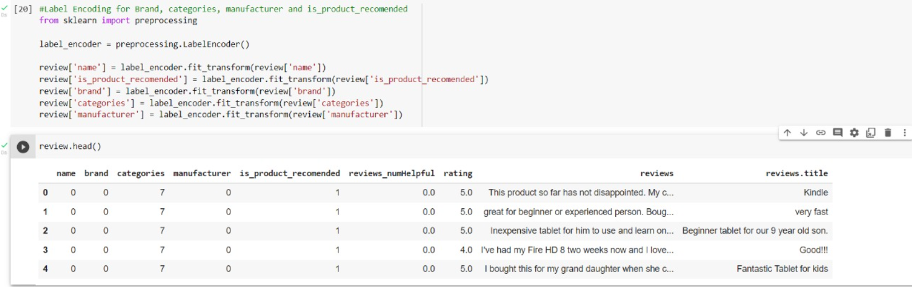
Data preprocessing
Encoding

Slide 7
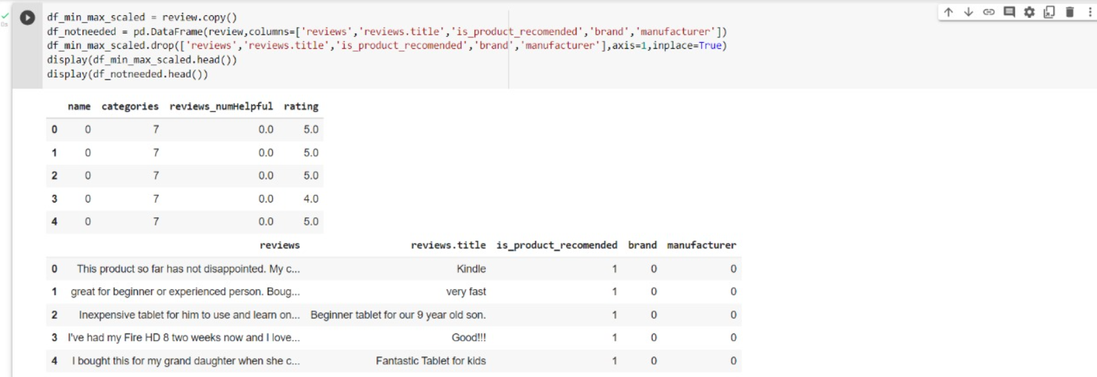
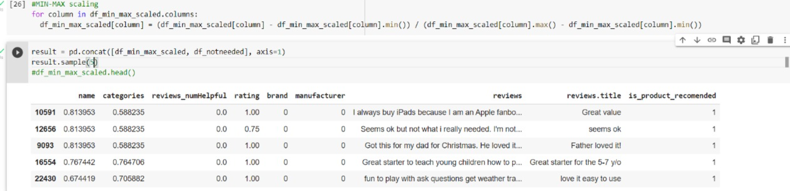
Data preprocessing
Feature scaling
(normalization)

Slide 8
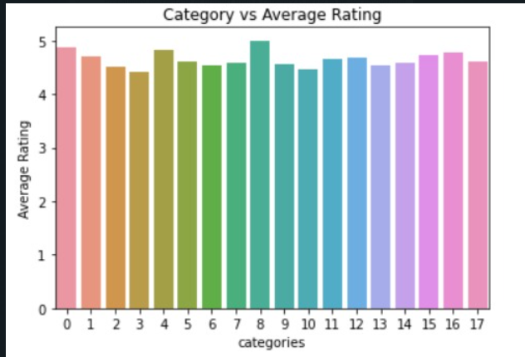
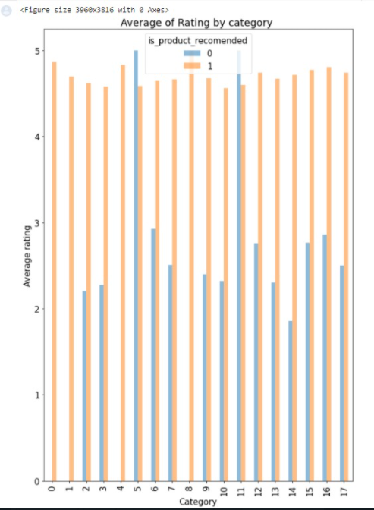
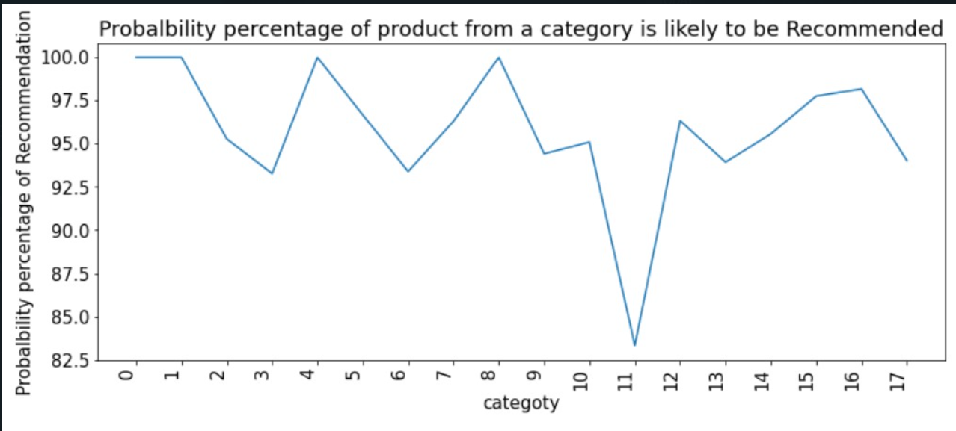
Data visualisation

Slide 9
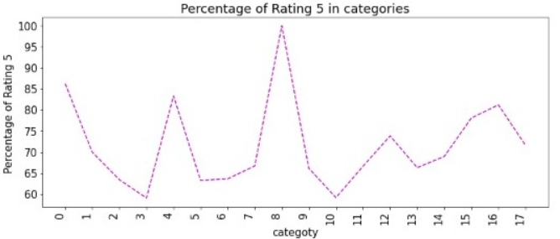
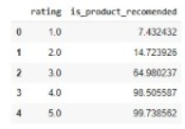
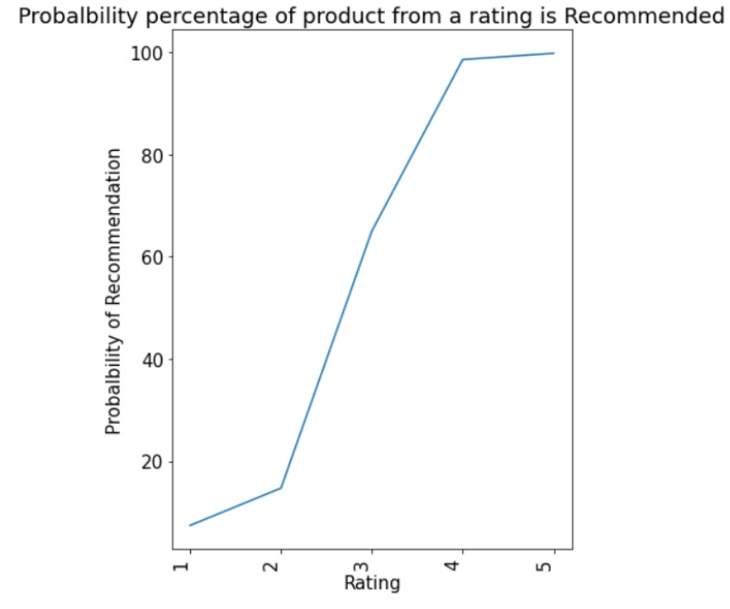
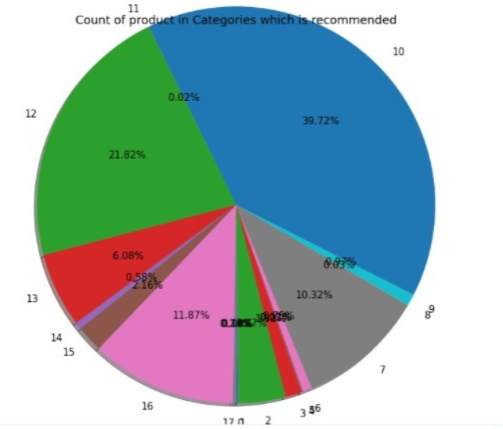
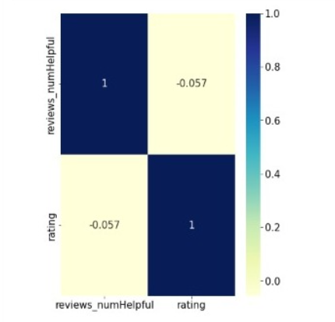
Data visualisation

Slide 10
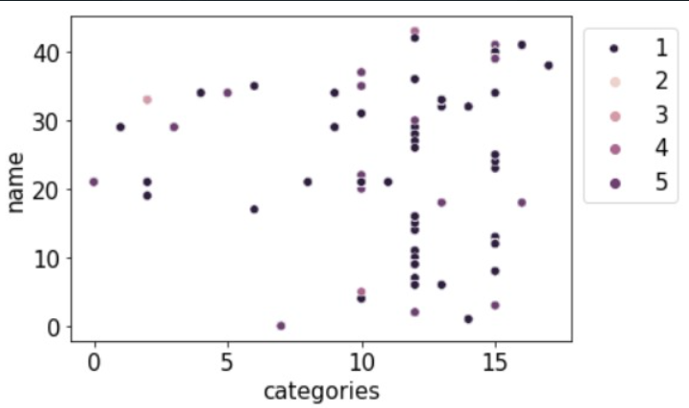
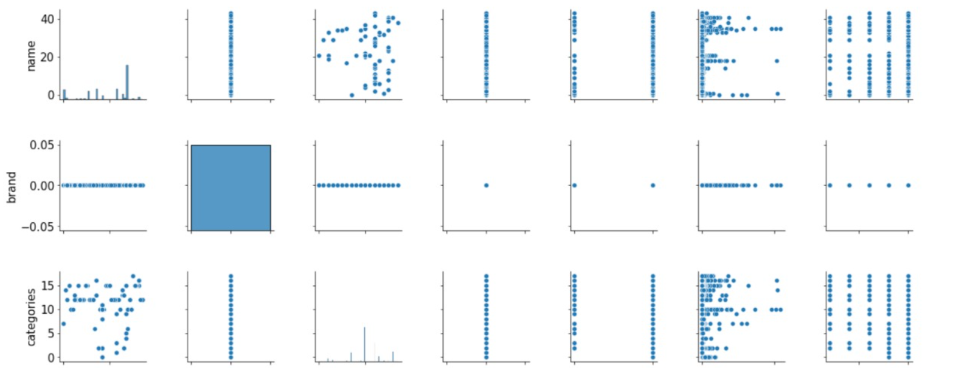
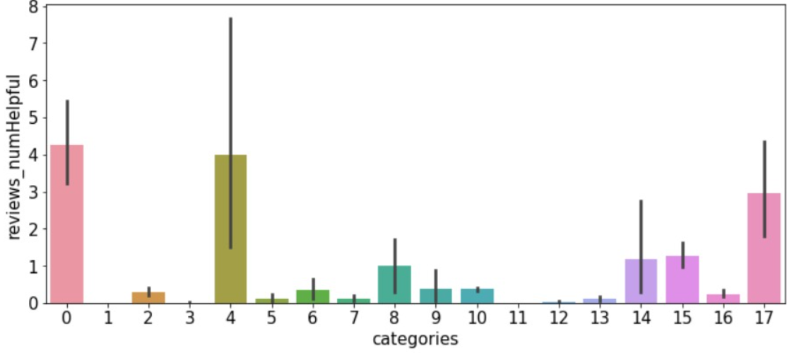
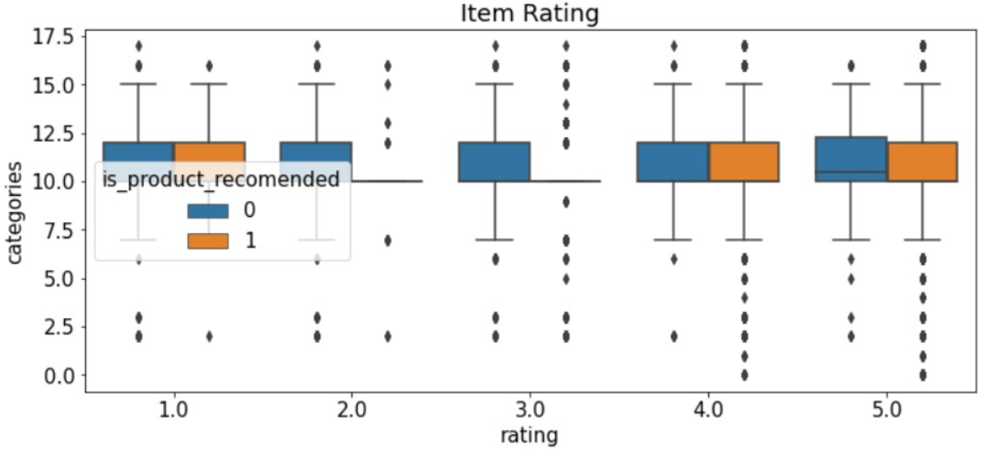
Data visualisation

Slide 11
Sentiment analysis
Sentiment analysis (or opinion mining) is a natural language processing (NLP) technique used to determine whether data is positive, negative or neutral. Sentiment analysis is often performed on textual data to help businesses monitor brand and product sentiment in customer feedback, and understand customer needs.
There are three stages of sentiment analysis
1) data preprocessing ( WRT sentiments)
2) feature extraction
3) choosing ML algorithm

Slide 12
Data preprocessing
Tokenization — convert sentences to words Removing unnecessary punctuation, tags.
Removing stop words — frequent words such as ”the”, ”is”, etc. that do not have specific semantic.
Stemming — words are reduced to a root by removing inflection through dropping unnecessary characters, usually a suffix.
Lemmatization — Another approach to remove inflection by determining the part of speech and utilizing detailed database of the language.

Slide 13
Feature extraction
We use two techniques to feature extract
1) polarization
2) vectorization

Slide 14
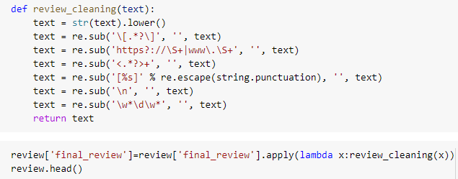
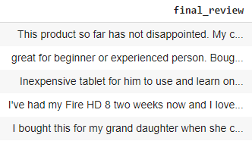
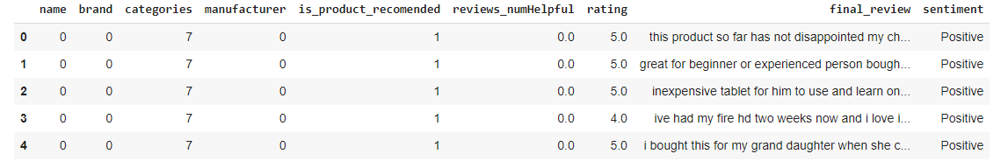
Text Cleaning
Text Punctuations cleaning :
Before punctuation cleaning:
After punctuation cleaning:

Slide 15
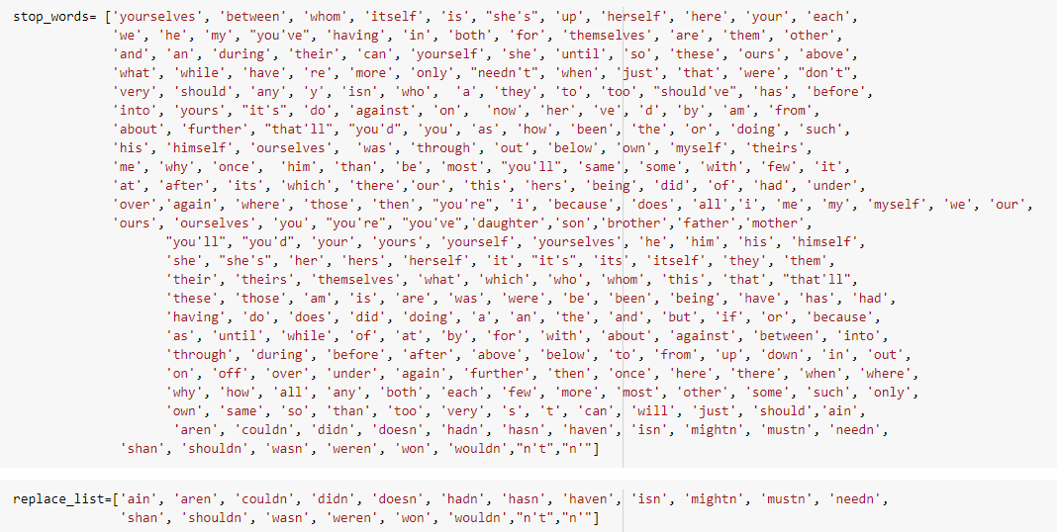
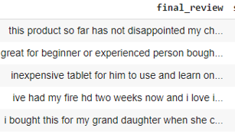
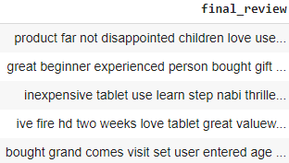
Removing stop words
Before stop words removal:
after stop words removal:

Slide 16
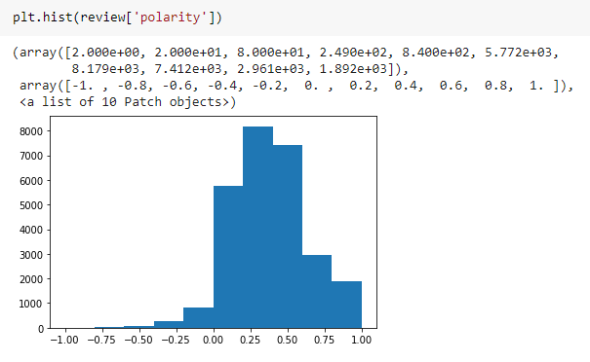
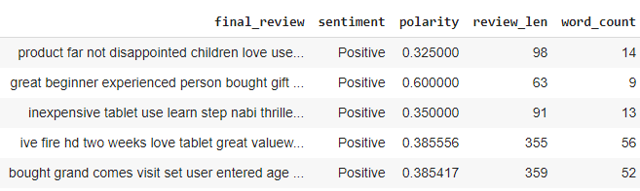
Polarity
Polarity: We use Textblob for for figuring out the rate of sentiment . It is between [-1,1] where -1 is negative and 1 is positive polarity
Review length: length of the review which includes each letters and spaces
Word length: This measures how many words are there in review

Slide 17
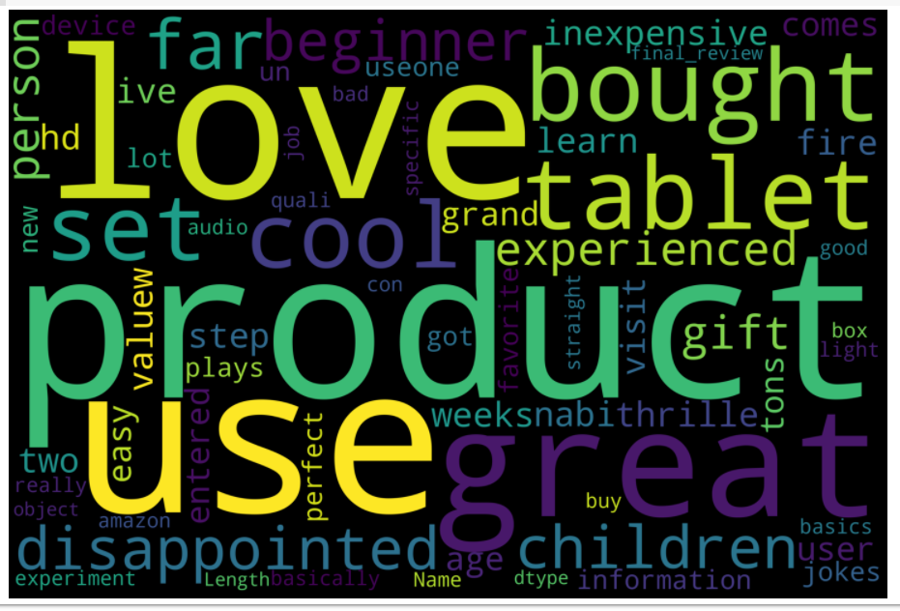
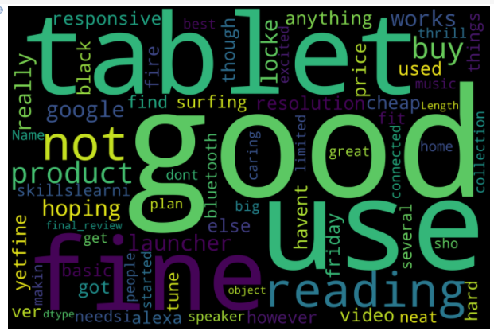
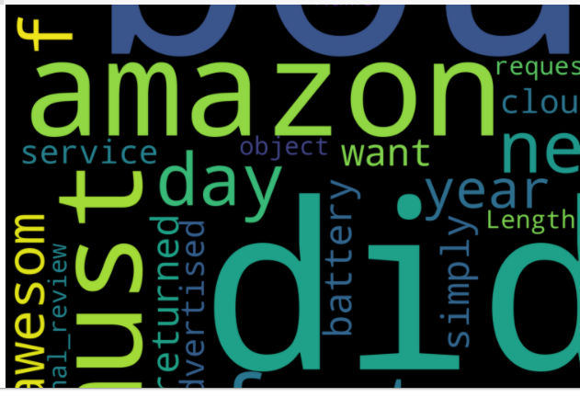
Word screening
Positive strings
Negative strings
neutral strings

Slide 18
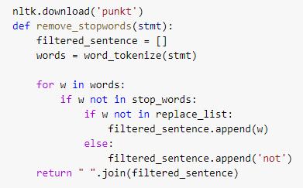
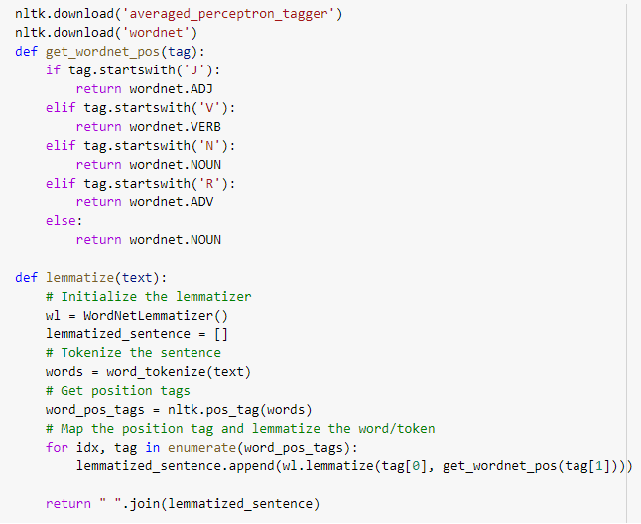
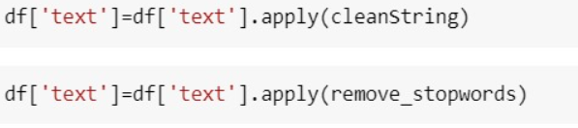
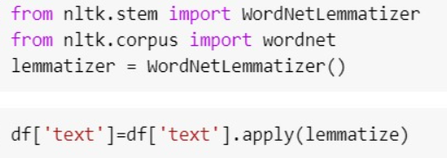
Tokenization

Slide 19
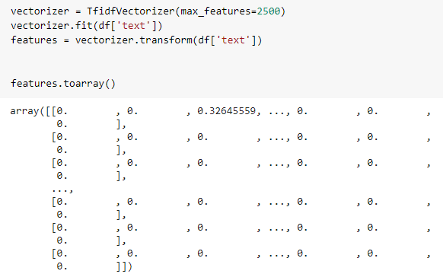
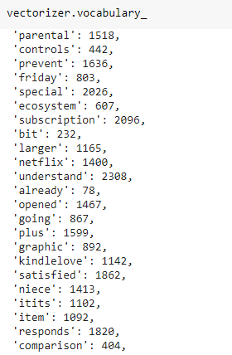
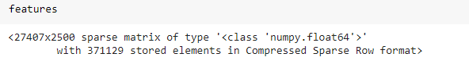
TFIDF VECTORISATION
VOCABULARY

Slide 20
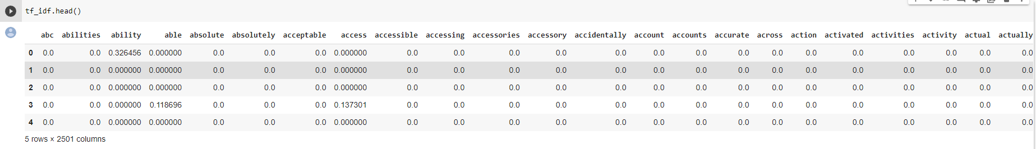
Final dataframe

Slide 21
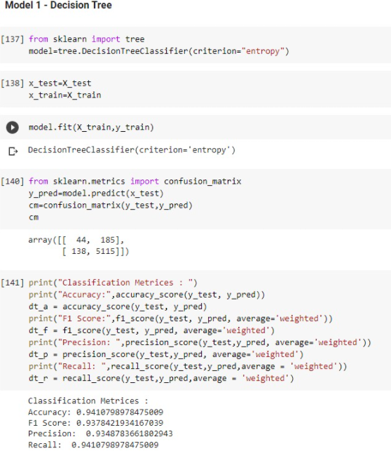
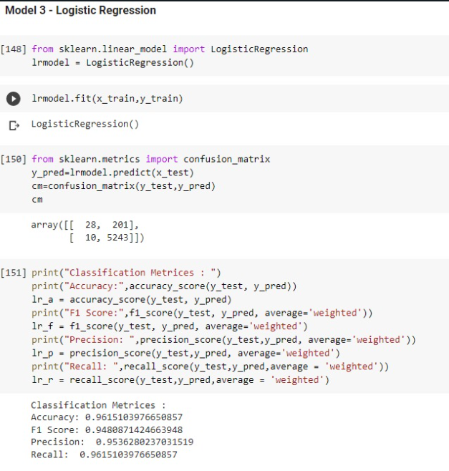
Model building and metrics

Slide 22
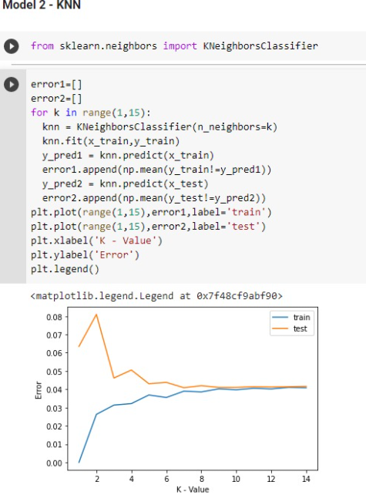
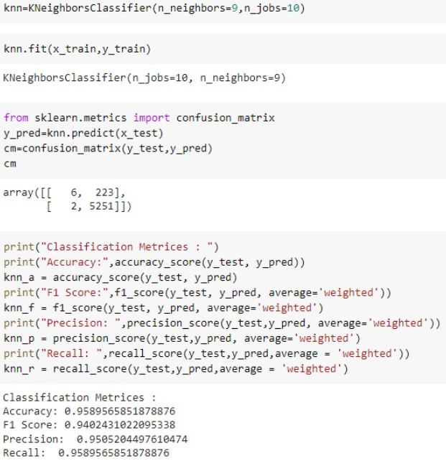
Model building & metrics

Slide 23
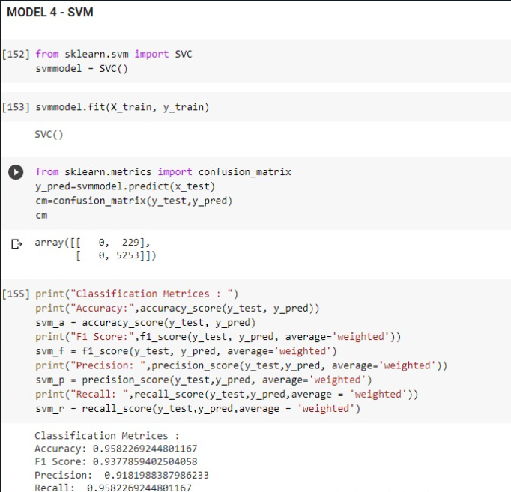
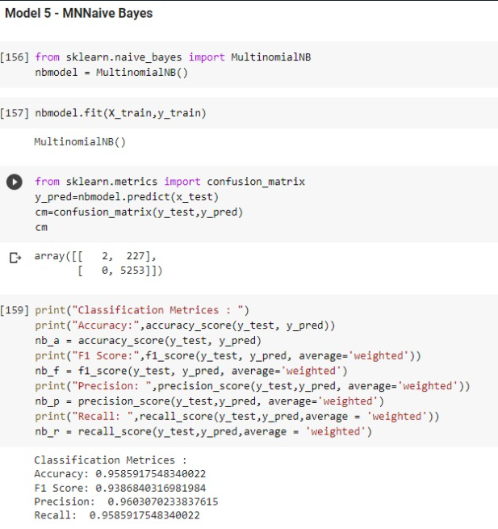
Model building & metrics

Slide 24
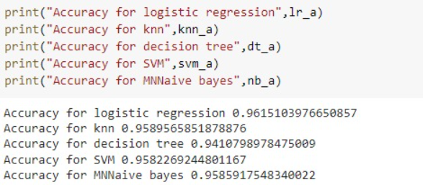
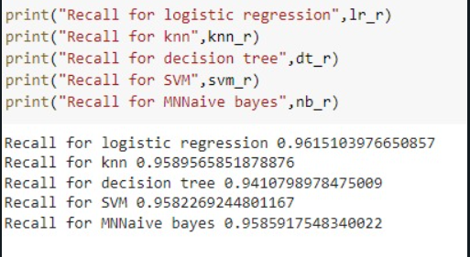
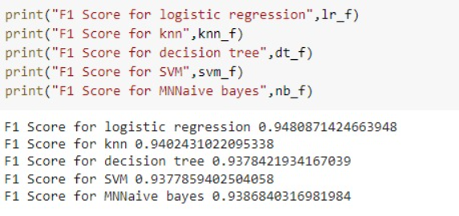
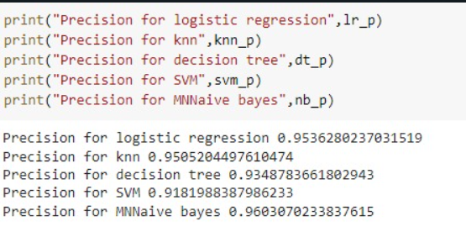
Analysis

Slide 25
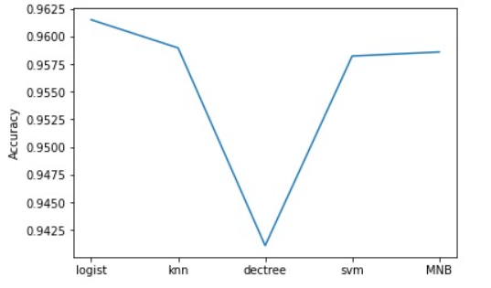
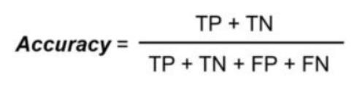
Analysis on findings
We have analyzed 5 machine learning models namely Logistic Regression, KNN, Decision Tree, SVM, MNNaive Bayes with the help of 4 classification metrices i.e accuracy, precision, recall , f1 score.
As our objective is to make a recommendation model we have chosen accuracy as our primary metrics to select the best model.
Amongst the five models that we analyzed logistic regression is having the highest accuracy with an accuracy of 0.96151039766.
So we have selected logistic regression as our model.

